Slide 1
Software Testing
Comprehensive overview for trainees and placement-ready professionals

Slide 2
Introduction
Software testing ensures software meets quality, reliability, and user expectations. This presentation covers core concepts, methodologies, tools, and best practices to prepare trainees for real-world projects and interviews.
Refer to Elysium Academy resources and the GitHub repository for notes and resumes: https://github.com/Narthana-Elysium

Slide 3

01
Topic 1

Slide 4
Testing Fundamentals
Definition: Testing is the process of evaluating software to find defects and verify requirements.
Key areas: test objectives, test levels (unit, integration, system, acceptance), and test lifecycle. Emphasize quality assurance and the role of testers in the SDLC.

Slide 5
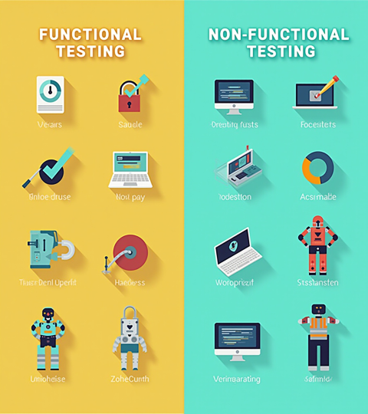
Testing Types Overview
Overview of functional vs. non-functional testing, including regression, smoke, sanity, performance, security, and compatibility , manual and automation testing.
Highlight when to apply each type, typical tools, and how testing type selection impacts release readiness and customer satisfaction.

Slide 6
SDLC & STLC
SDLC defines software phases: requirements, design, development, testing, deployment, maintenance.
STLC focuses on testing activities: requirement analysis, test planning, case design, environment setup, execution, defect reporting, closure. Emphasize quality ownership and early test involvement.

Slide 7

01
Topic 2

Slide 8
Test Design Techniques
Use Equivalence Partitioning and Boundary Value Analysis to optimize test cases.
Apply decision tables, state transition testing, and use-case testing to cover complex logic while keeping test coverage efficient.

Slide 9
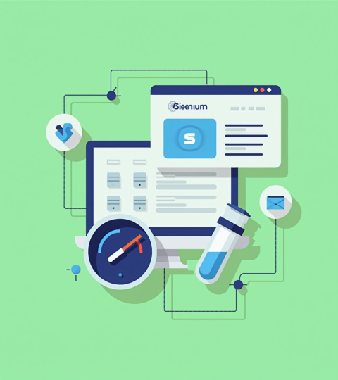
Tools & Automation
Select tools by need: Selenium for UI, Postman for API, JMeter for performance, JUnit/TestNG for unit testing.
Integrate with CI/CD pipelines and version control to enable repeatable automation and faster feedback.

Slide 10
Reporting & Metrics
Track defect density, test coverage, pass/fail rates, and mean time to detect to evaluate quality.
Use clear dashboards and concise reports for stakeholders, highlighting critical risks and release readiness with actionable insights.

Slide 11
Conclusions
Testing ensures product reliability and user satisfaction through systematic practices across SDLC.
Adopt robust test design, appropriate tools, and meaningful metrics to drive continuous improvement and placement-ready skills for trainees.

Slide 12
Thanks!
Do you have any questions?
youremail@freepik.com
+91 620 421 838
yourcompany.com
Please keep this slide for attribution

